Slide 1
FOOD DIET AND NUTRITION MANAGEMENT
BHARADWAJ GUNDU - 700756406
PRATEESH URATI -700779551
JAI SRINIVAS BATHULA - 700777296
MUSKE VAMSHI-700776998

Slide 2

Introduction
Food Diet is an advanced web-based Diet and Nutrition Management System designed to help individuals plan, track, and manage their dietary habits and exercise routines effectively. The system is structured to provide a seamless experience for three key user roles: Admin, Nutritionist, and User, ensuring a well-organized and efficient approach to diet management.

Slide 3
The Admin Module plays a crucial role in ensuring the accuracy and reliability of the Food Diet system. Administrators are responsible for managing the platform by securely logging in and overseeing all nutrition-related data. They verify and approve diet plans submitted by registered nutritionists to ensure that only authentic and well-structured meal plans are available to users. By maintaining data integrity and monitoring the system, admins help create a trustworthy platform where users can confidently follow diet recommendations for a healthier lifestyle.
The Nutritionist Module is designed to help nutritionists create and manage personalized diet plans tailored to users' health needs. Nutritionists can register and log in to the system to access its features. They have the ability to add, modify, and update diet plans, ensuring that each plan includes well-balanced food items along with their nutritional values. Additionally, they can define meal schedules and recommended diet timings to help users maintain a structured eating routine. To promote a holistic approach to health, nutritionists can also integrate exercise recommendations into diet plans, ensuring a balance between nutrition and physical activity. Furthermore, they can maintain food and exercise logs, linking meal plans with relevant workouts to enhance users' overall well-being.

Slide 4
The User Module is the core of the Food Diet system, providing users with a personalized platform for diet tracking and health monitoring. Users begin by securely registering and logging into the system, where they can browse and select diet plans based on their individual health goals and preferences. Once a diet plan is chosen, they can follow structured meal programs designed by expert nutritionists.
To maintain consistency, users can track their daily diet intake by recording meals and updating their exercise activities, ensuring a balanced approach to nutrition and fitness. The Diet Dashboard provides a visual representation of their progress, including meal tracking and calorie consumption, helping them stay on track with their health objectives.
Additionally, users can engage with the platform by providing feedback and ratings on diet plans, allowing others to benefit from their experiences. They can also participate in discussion forums, sharing insights, asking questions, and gaining knowledge from the community. This interactive and structured approach ensures that users receive guidance, motivation, and the necessary tools to achieve their dietary and fitness goals effectively

Slide 5
Nutritionists can upload their food plans on the website and set a price for each plan. Users must make a payment to access these diet plans. From each transaction, the admin will receive a 15% commission before transferring the remaining amount to the nutritionist. In addition to choosing pre-set plans, users have the option to connect with nutritionists for customized diet plans based on their specific needs. Nutritionists are responsible for keeping track of all users who enroll in their plans and ensuring they receive proper guidance. They must also monitor user ratings, reviews, and comments to improve their services. Engaging with user feedback helps nutritionists enhance the quality of their plans and build trust with their clients. This structured approach ensures a seamless experience for both users and nutritionists while maintaining the platform’s credibility

Slide 6
Database Description
The Food Diet Nutrition Management database is comprised of 13 distinct collections, Admin, Nutritionist, Food Timings, Food in Diet, User, User Food, Diet_Plan, User Diet, User Exercise, Exercise in Diet, Exercise Timings, Payments, and Reviews, which collectively facilitate comprehensive management of nutritional data.
ADMIN:
The administrator can access the system using default login credentials, consisting of a username and password, which are securely stored in the Admin collection, comprising the fields admin_id, user_name, and password.
Upon successful login, the administrator can view and verify the registration details of nutritionists, whose information is stored in the Nutritionist collection, comprising fields such as nutritionist_id, name, email, phone, password, address, about, picture, and status. Notably, a nutritionist's status must be verified by the administrator to enable login access to the website, ensuring secure and authorized access.

Slide 7
Upon successful login, the administrator can view and verify the registration details of nutritionists, whose information is stored in the Nutritionist collection, comprising fields such as nutritionist_id, name, email, phone, password, address, about, picture, and status. Notably, a nutritionist's status must be verified by the administrator to enable login access to the website, ensuring secure and authorized access.
NUTRITIONIST:
Upon successful login with their valid email and password credentials, nutritionists can access the system to create and manage diet plans. Specifically, they can add and view food diet details, which are stored in the Diet collection. This collection comprises comprehensive fields, including diet_plan_id, diet_title, diet_price, age_range (age_from and age_to), instructions, image, about_diet, diet_for, calories_to_be_burned, calories_to_be_consumed, status, and nutritionist_id (a reference key linked to the Nutritionist collection), enabling the secure storage and organization of food diet data.

Slide 8
DIET:
The diet plans refer to the personalized nutrition programs uploaded by nutritionists on the website, each with a corresponding price. To access these plans, users must make a payment.
Once a user purchases a diet plan, the nutritionist is responsible for monitoring the user's progress and providing ongoing guidance.
For users enrolled in their diet plans, nutritionists can update the following information:
User foods: the specific foods and meals recommended for the user
Food timings: the scheduled times for the user to eat, ensuring they stay on track with their personalized diet plan.
Exercise: the physical activities and workouts recommended for the user
Exercise in diet: the integration of exercise routines into the user's personalized diet plan, ensuring a comprehensive approach to their health and wellness.

Slide 9
FOOD TIMING:
Once a food diet is created, the nutritionist can proceed to add and schedule food timings, tailoring the food diet to include specific meal schedules. The food_timings collection comprises comprehensive fields, including food_timing_id, food_timing_title, food_time, calories_can_taken, and diet_plan_id (a reference key linked to the Diet collection). This data can be stored in the admin food_timings collection.
FOOD IN DIET:
With the food timings scheduled, the nutritionist can then add specific foods to the diet plan, creating a comprehensive and personalized meal plan for users. The food_in_diet collection contains the fields food_in_diet_id, food_name, quantity, units, preparation, process, facts[ ] array can stores, calories, carbohydrates, fats, proteins, and food_timing_id. Here, food_timing_id is the reference key from the food timings collection; this data can be stored in the Food_in_diet collection.

Slide 10
USERS:
Users can create an account by registering with their personal information. The user collection contains the following fields: name, email, phone, password, address, age, and gender. After a successful login, the user can browse the nutritionist's uploaded food_diet plans. However, to access these diet plans, the user must make a payment. Once registered, users can follow the personalized guidance provided by their assigned nutritionist, including customized recommendations for food intake (user_food), exercise routines (user_exercise), exercise schedules (exercise timings), and tailored diet plans (exercise_diet), empowering them to achieve their health and wellness goals.

Slide 11
USER DIET:
The user diet collection consists of the following fields: user_diet_id, status, and discussion_on_diet contains the array that can store the comments, date_time, user_id, and diet_plan_id. Here, user_id and diet_plan_id act as reference keys; this data can be stored in the user_diet collection. The user_food collection contains the user_food_id, quantity, date, user_diet_id, and food_in_diet_id's reference keys; these data can be stored in the user_food collection.
EXERCISE TIMINGS:
The exercise_timings collection contains the exercise_timing_id, exercise_title, exercise_time, calories_should_be_burn, and diet_plan_id. The diet_plan_id is a reference key. From the diet collection, these data can be stored in the exercise_timings collection.

Slide 12
EXERCISE IN DIET:
The exercise_in_diet collection contains the exercise_in_diet_id, exercise_type, exercise_name, duration, calories_burn, and exercise_timing_id reference key. These data can be stored in the exercise_in_diet collection.
USER EXERCISE:
The user_exercise collection contains the user_exercise ID, number of sets, date, exercise_in_diet_id, and user_diet_id's reference keys. These data can be stored in the user_exercise collection.

Slide 13
REVIEW:
Users have the opportunity to provide valuable feedback by leaving reviews and assigning ratings to specific diets, helping others make informed decisions and enabling nutritionists to refine and improve their diet plans. The review collection stores the following fields: review_id, rating, review, date, and user_id. Here, user_id acts as a reference key from the user collection; this data can be stored in the review collection.
PAYMENTS:
The payment collection stores the following fields: payment_id, amount, date, card_type, card_number, holder_name, status, cvv, expire_date, user_id, and user_diet_id. Here, user_id and diet_id act as reference keys; this data can be stored in the payment collection.

Slide 14
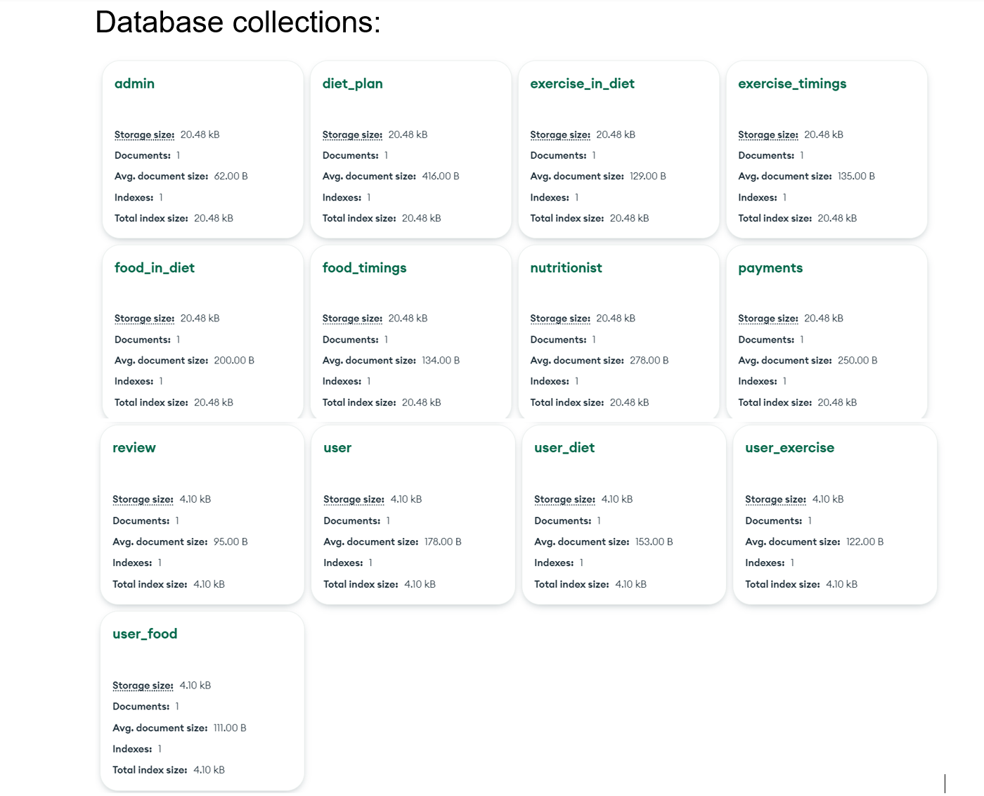

Slide 15
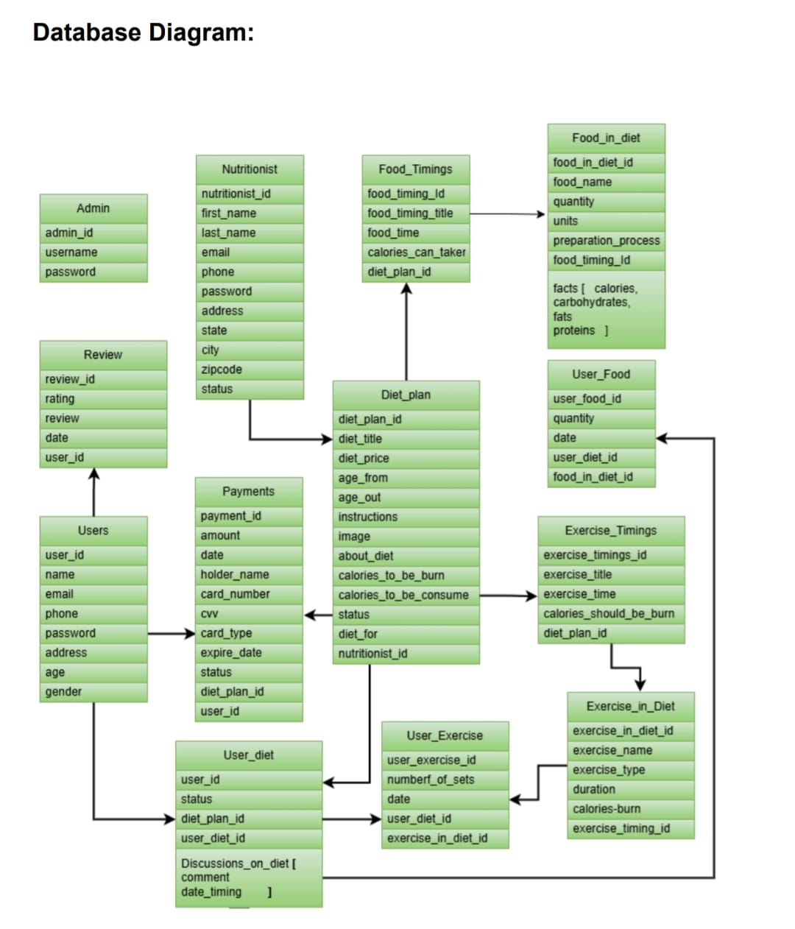
ER- Diagram

Slide 16
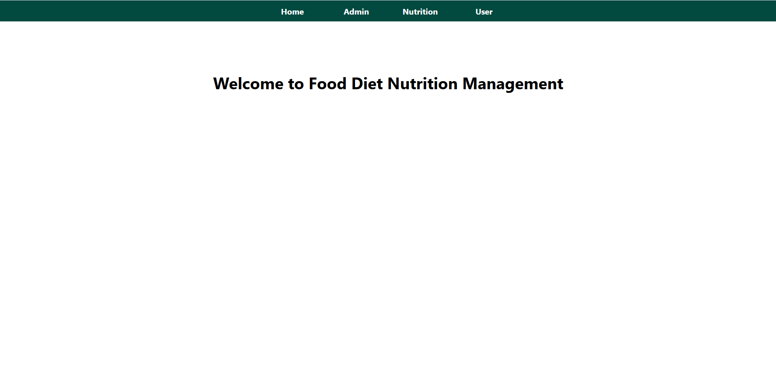
Website Main Page:

Slide 17
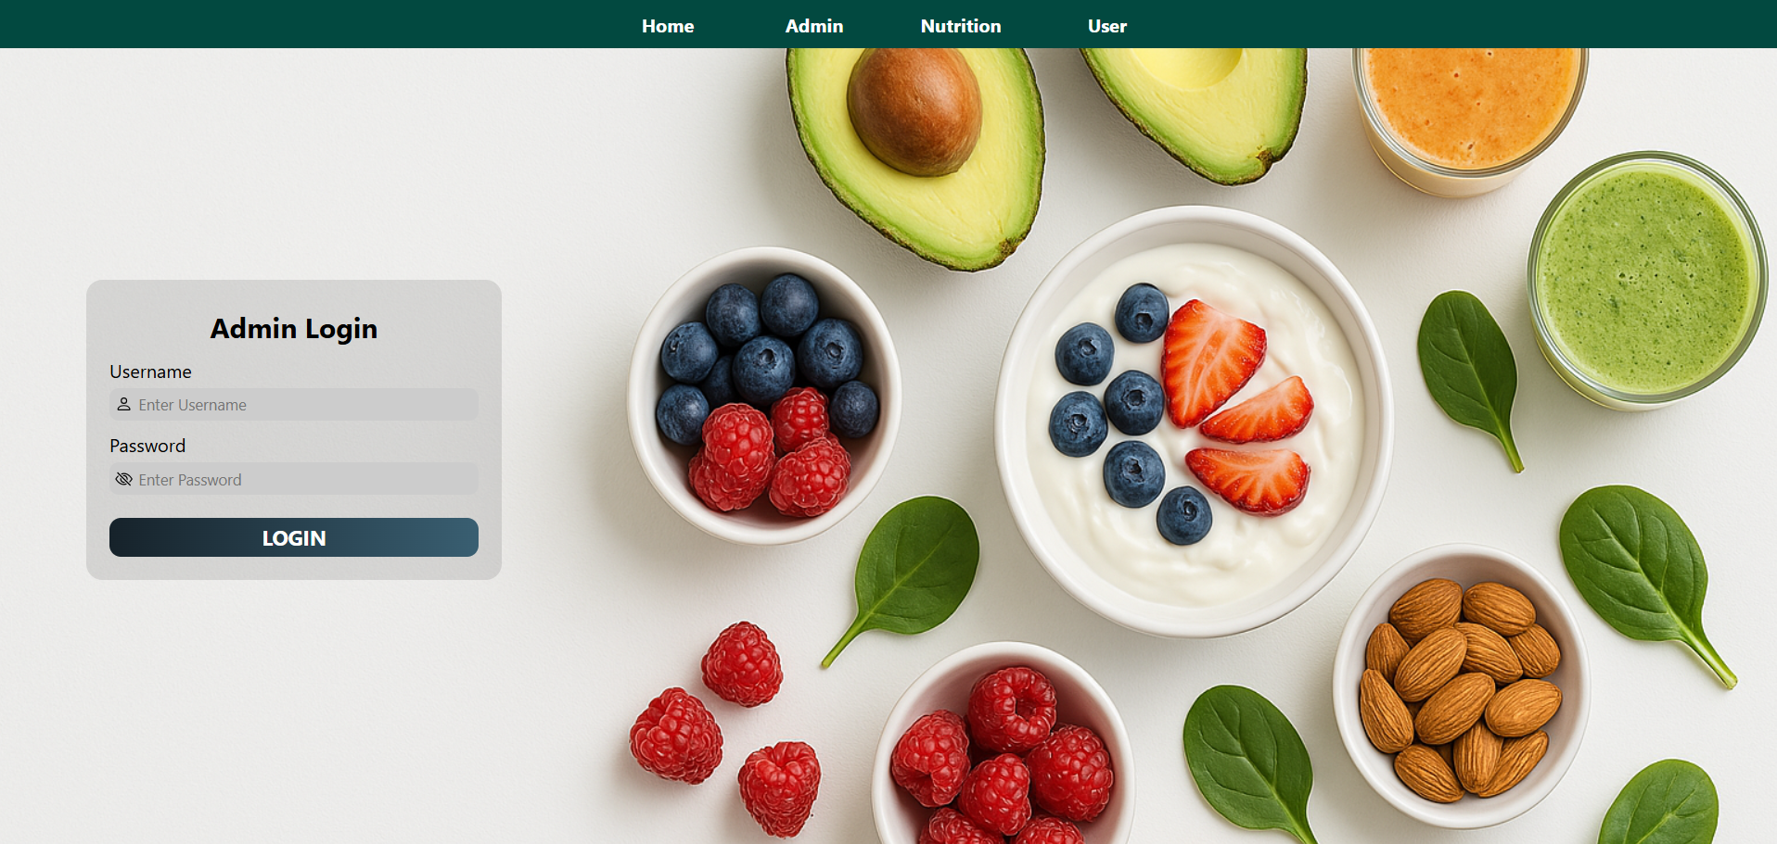
Admin Login Page:

Slide 18
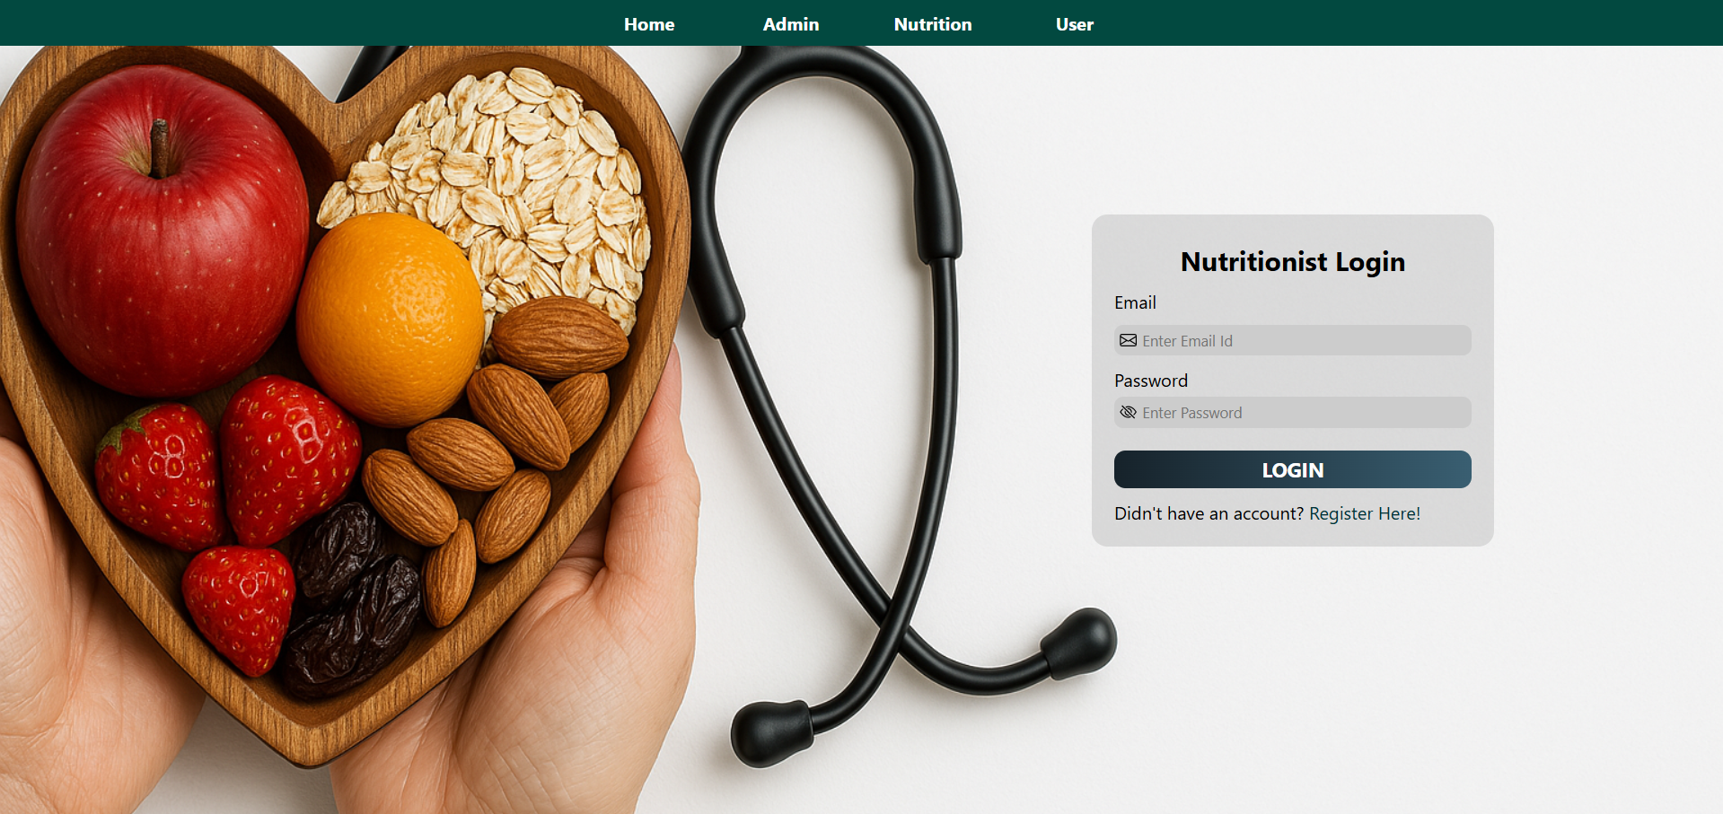
Nutritionist Login:

Slide 19
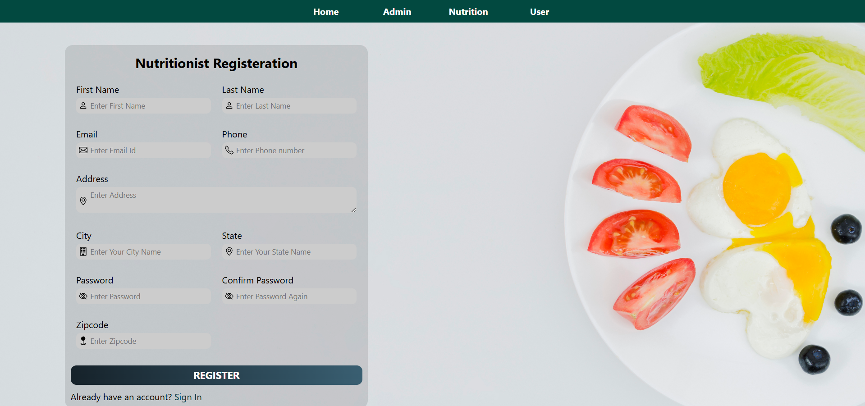
Nutritionist Registration:

Slide 20
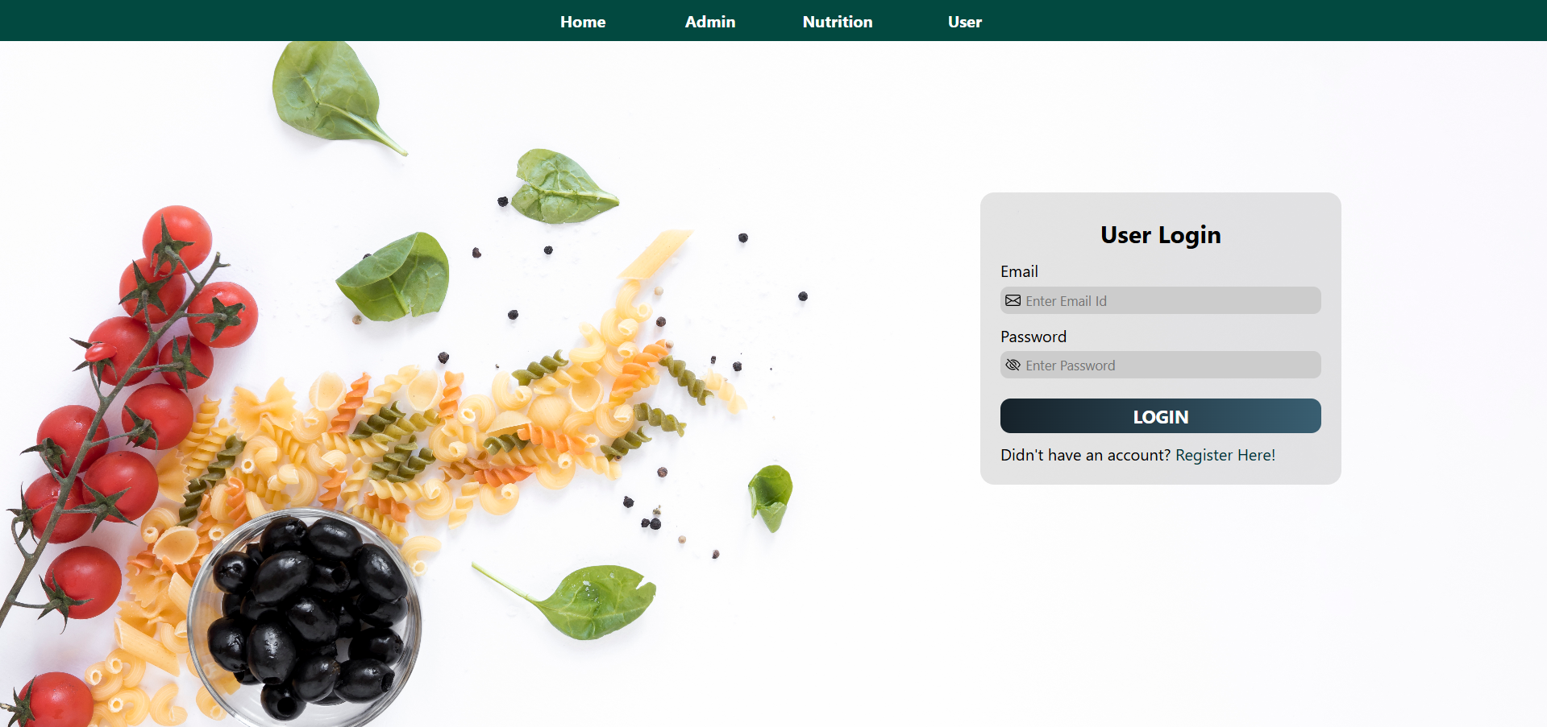
User Login:

Slide 21
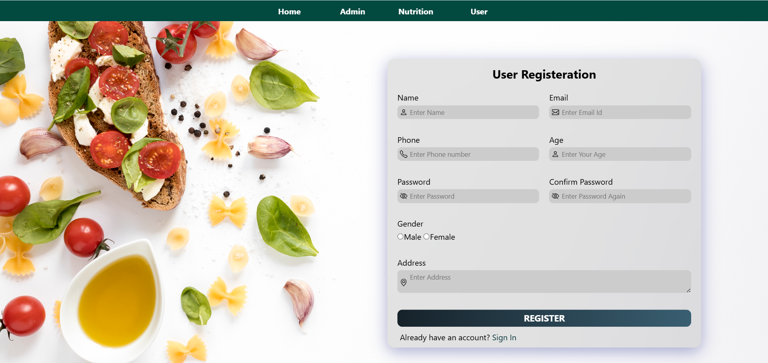
User Registration:

Slide 22
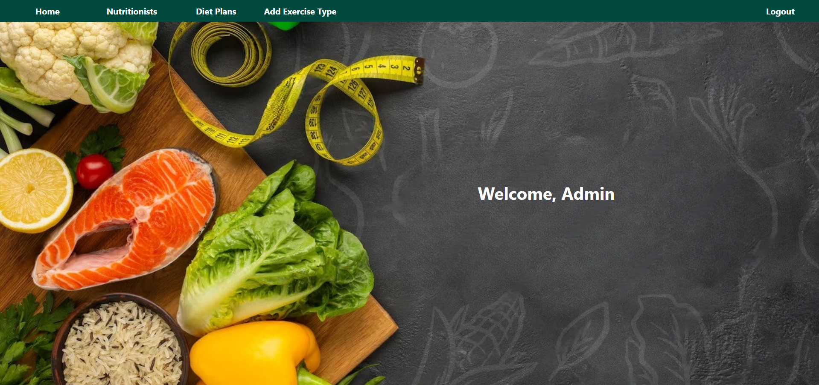
Admin Home:

Slide 23
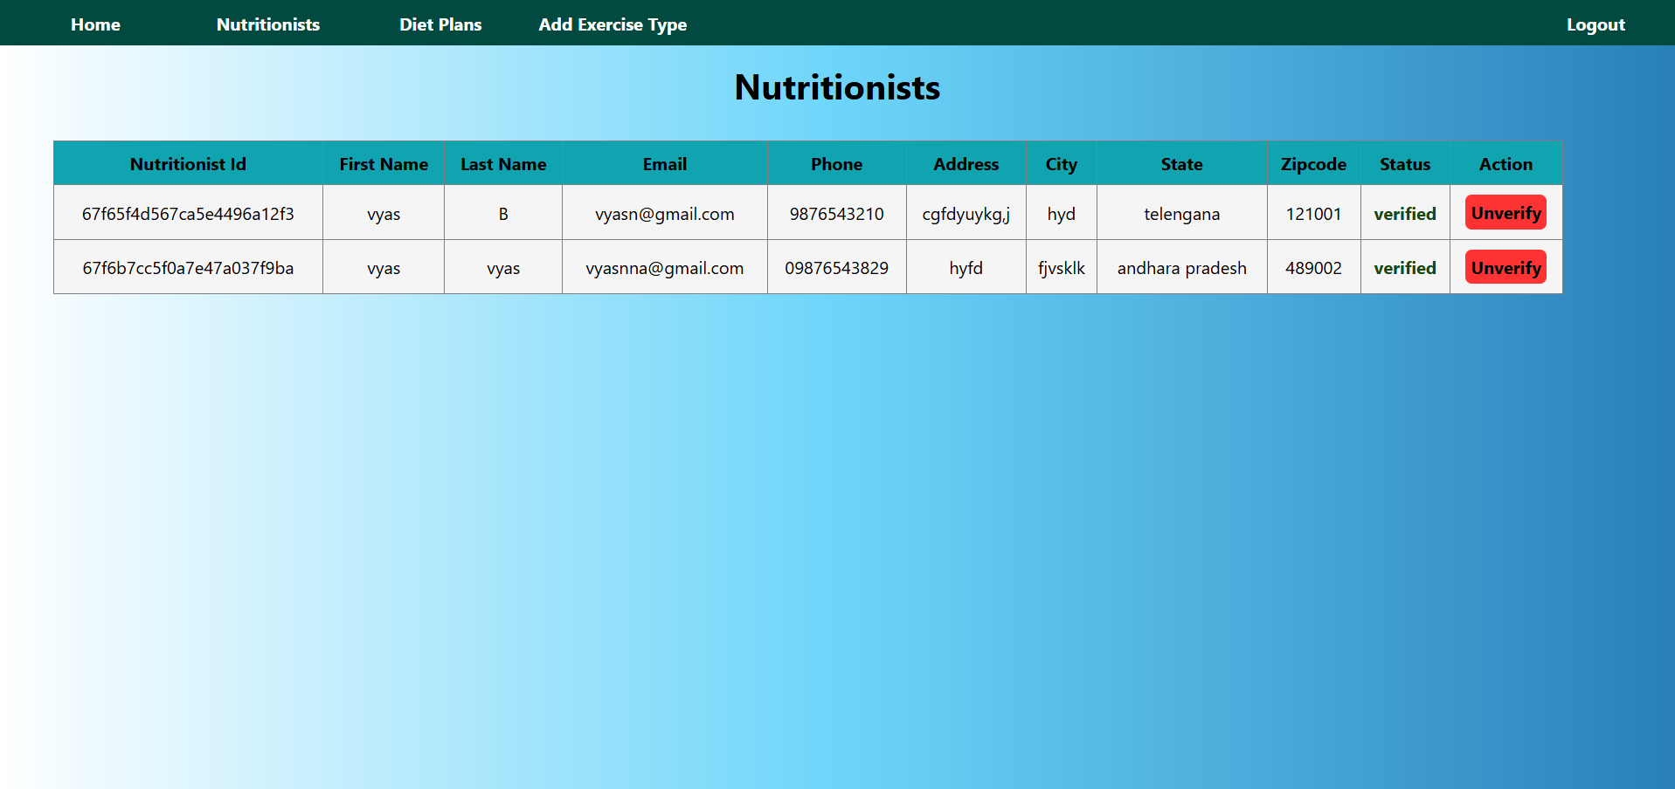
View & Verify Nutritions:

Slide 24
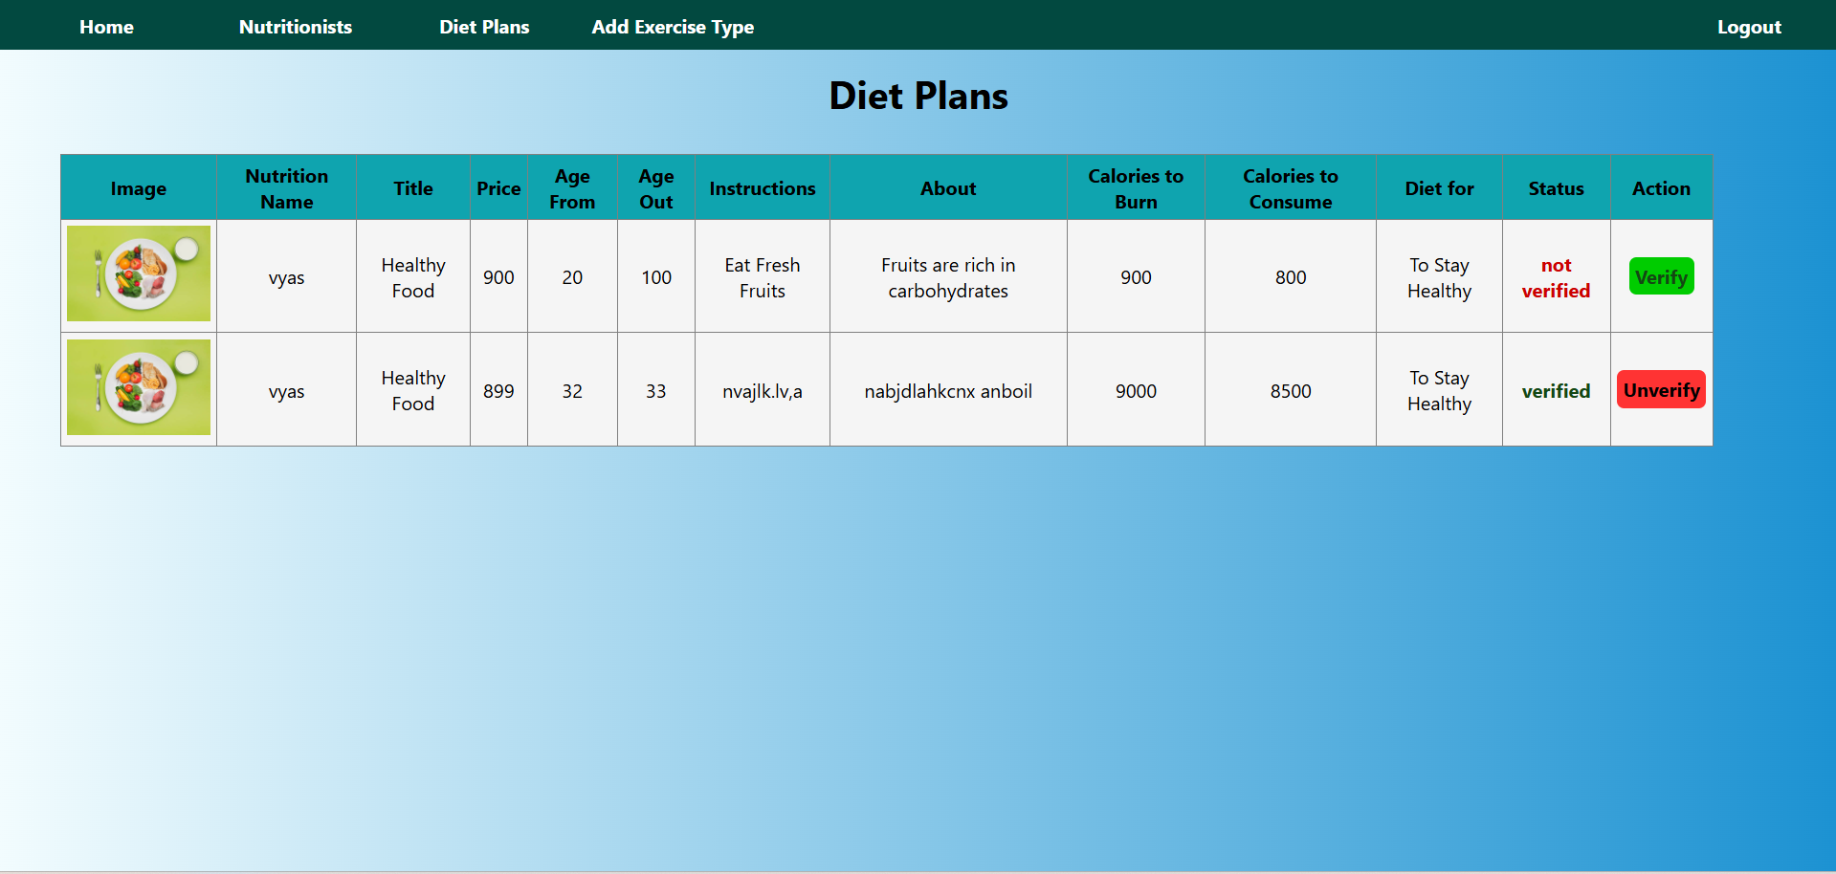
View & Verify Diet Plans:

Slide 25
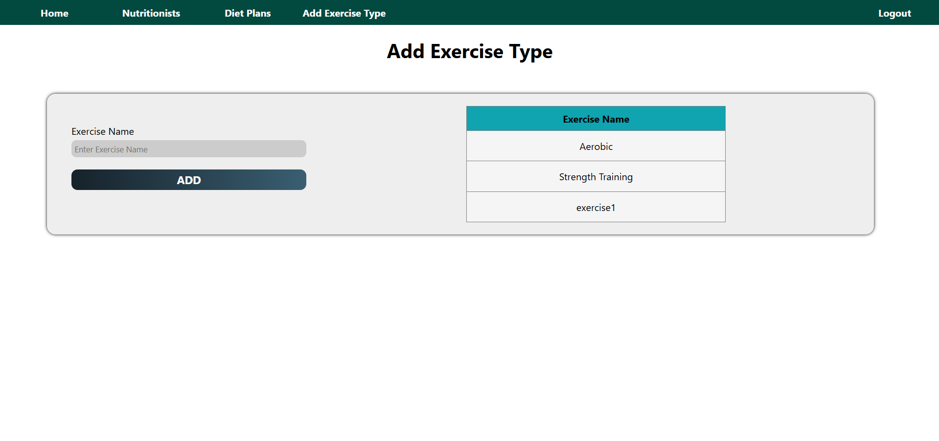
Add Exercise Type:

Slide 26
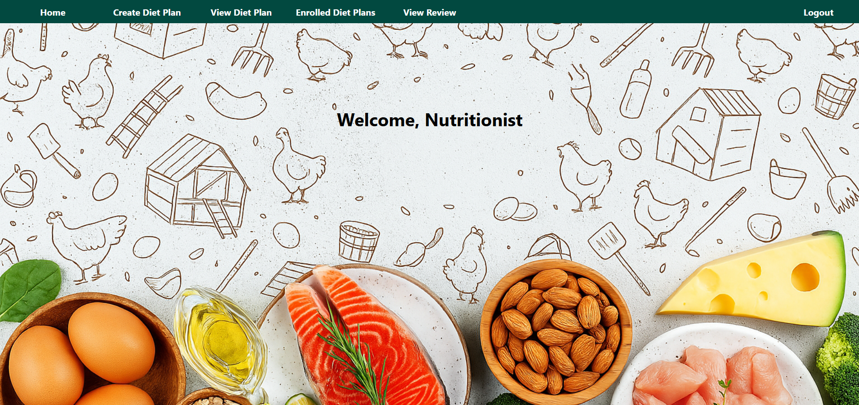

Nutritionist Home:

Slide 27
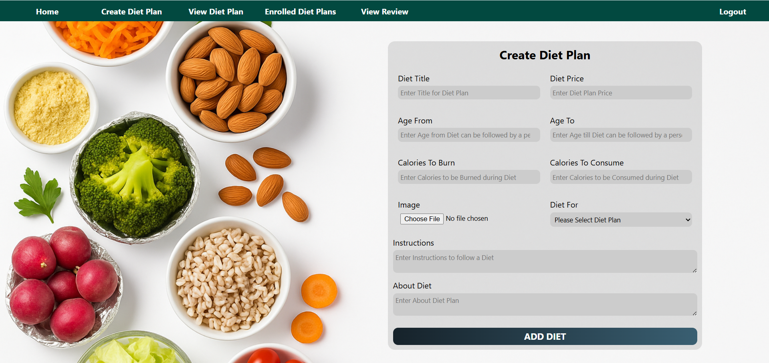
Create Diet Plan:

Slide 28
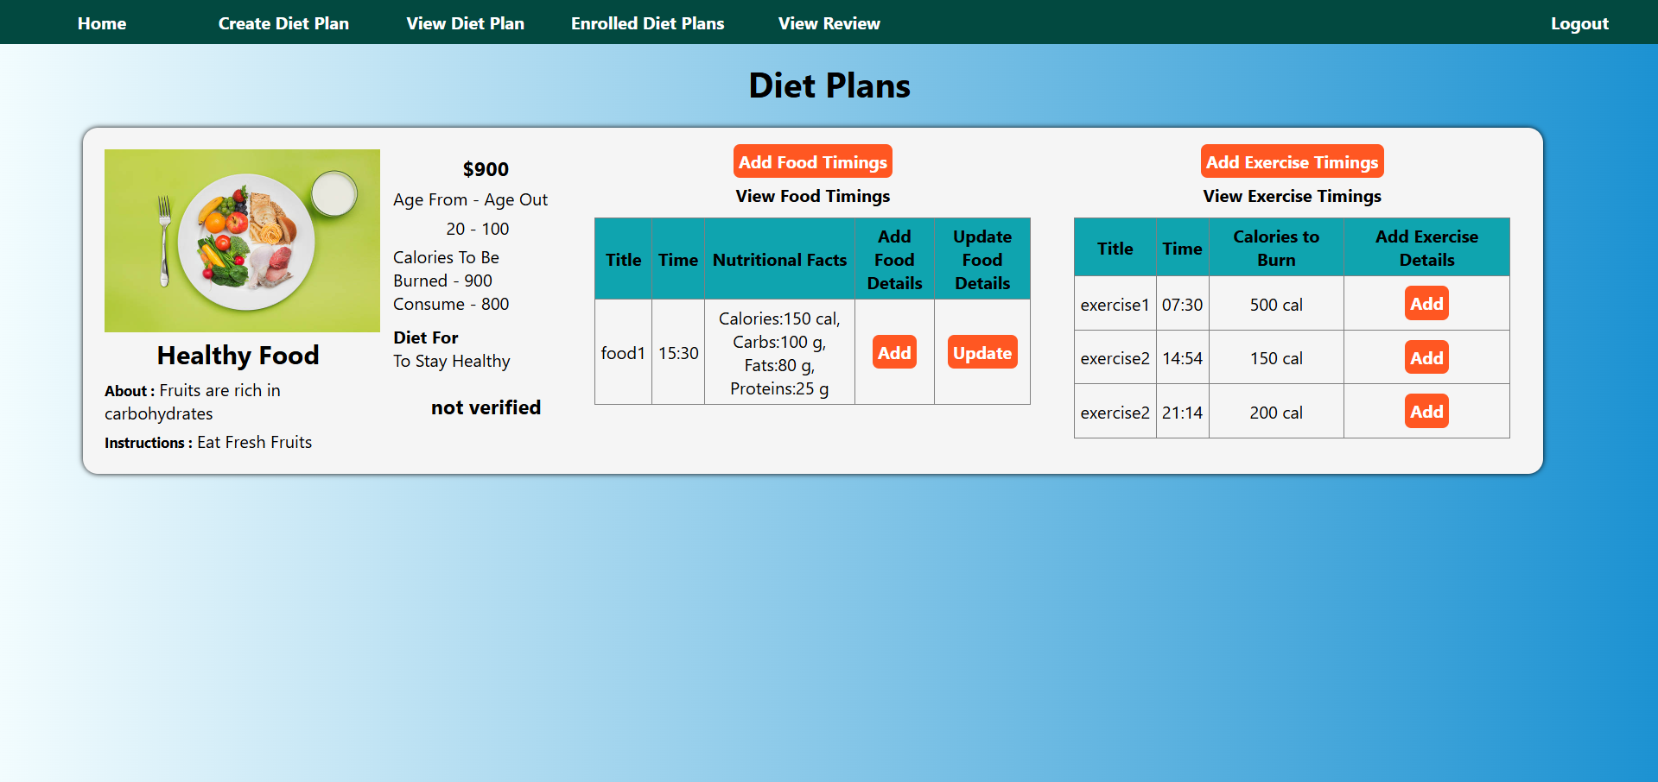
View Diet Plan:

Slide 29
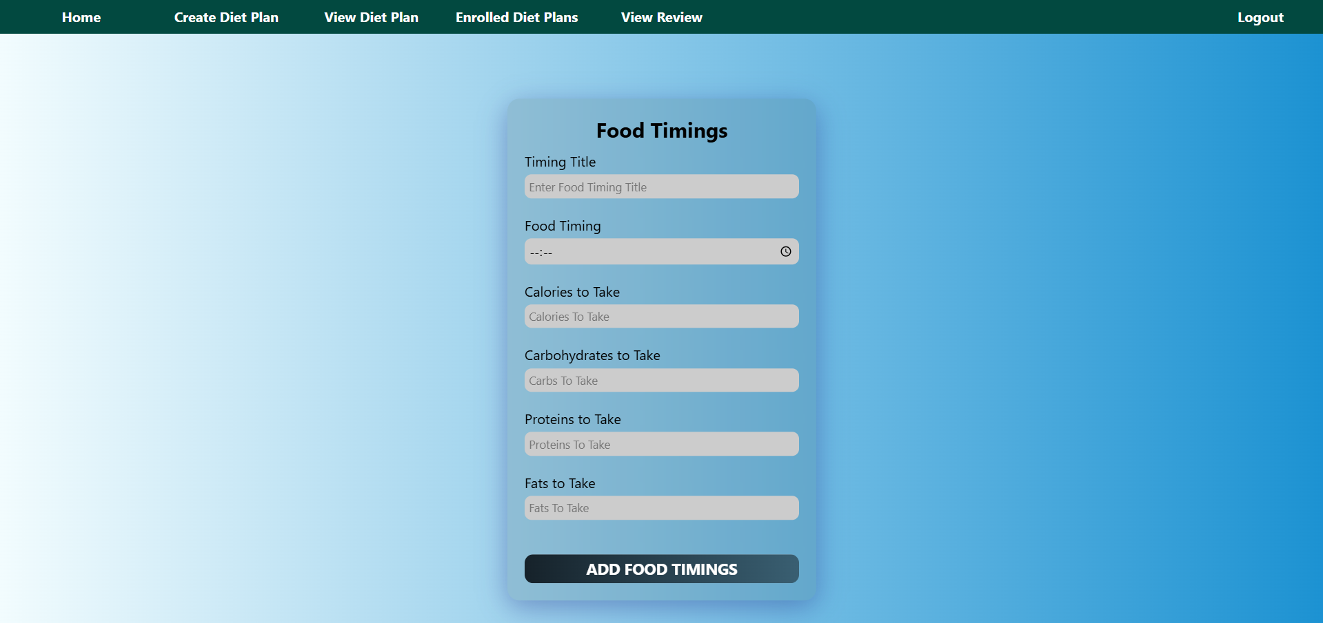
Add Food Timings:

Slide 30
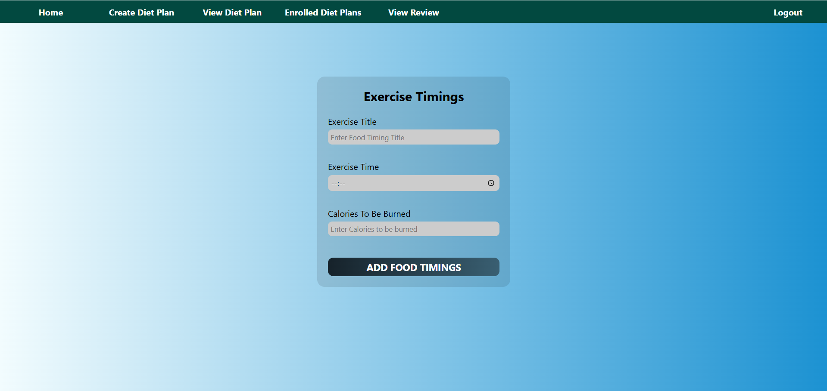
Add Exercise Timings:

Slide 31
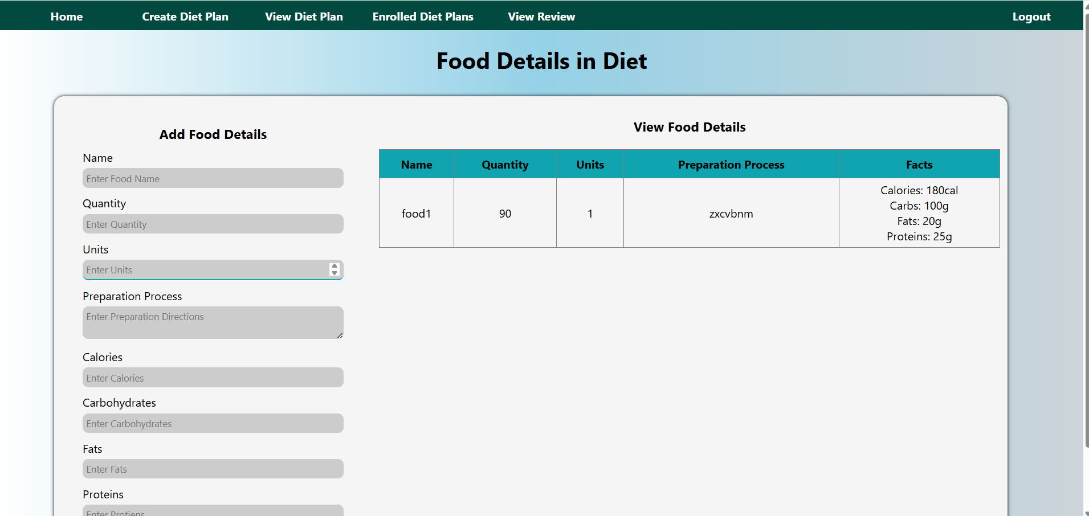
Add Food in Diet:

Slide 32
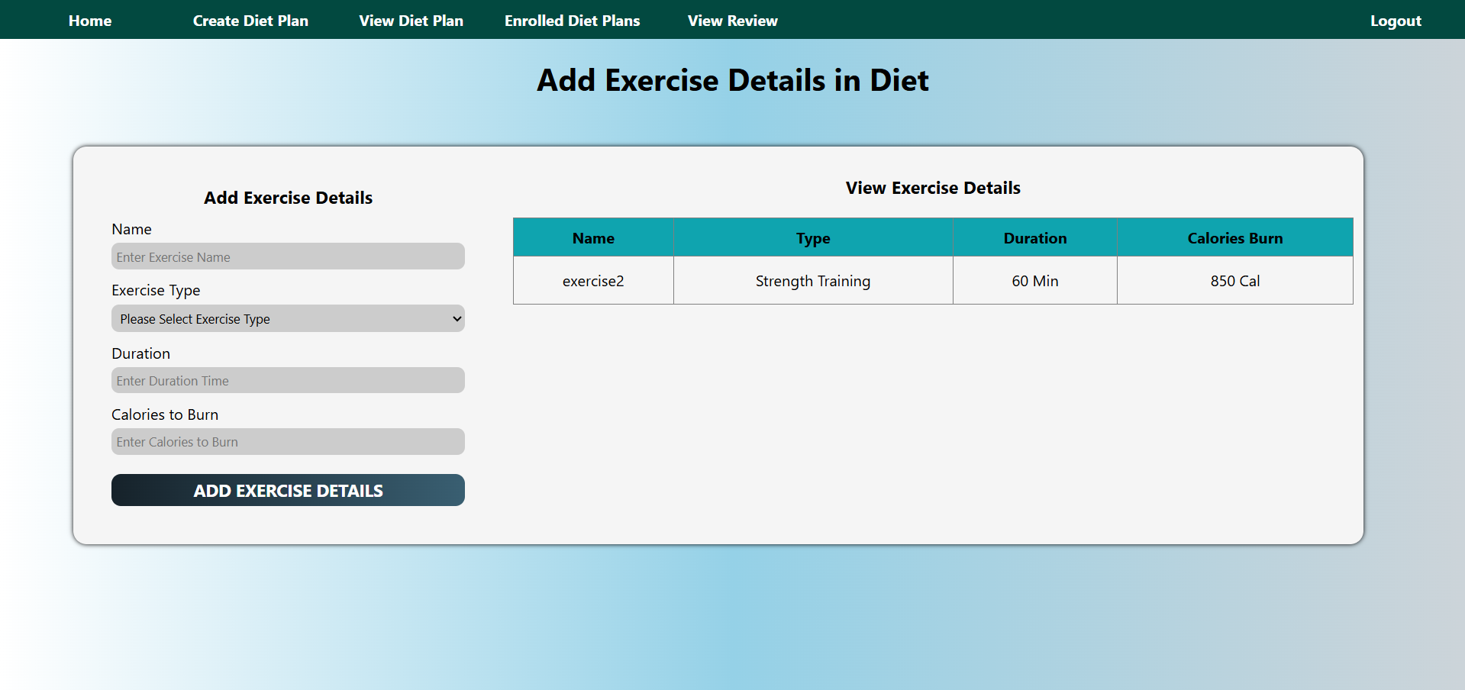
Add Exercise in Diet:

Slide 33
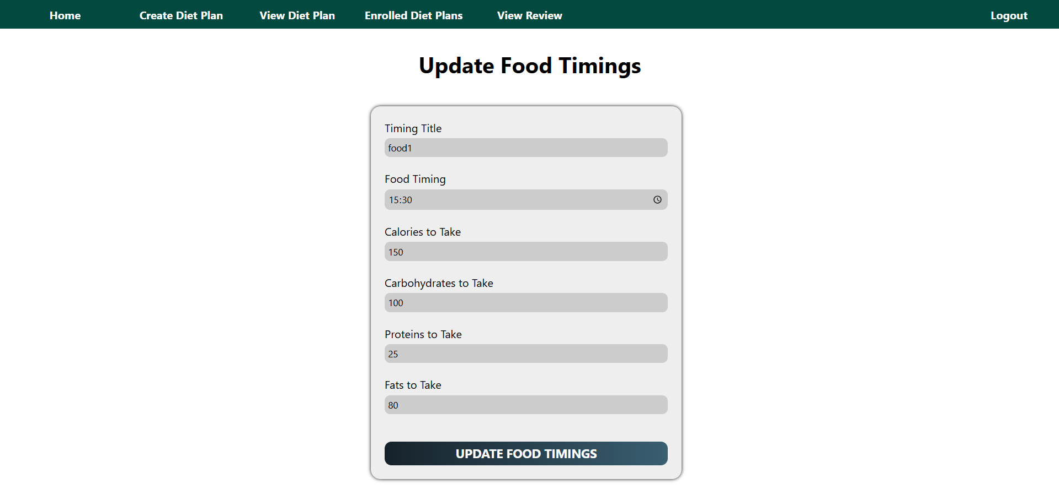
Update Food in Diet:

Slide 34
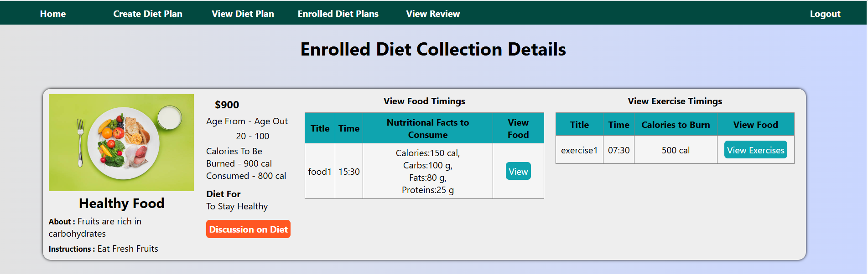
User Enrolled Diet Plans in Nutritionist:

Slide 35
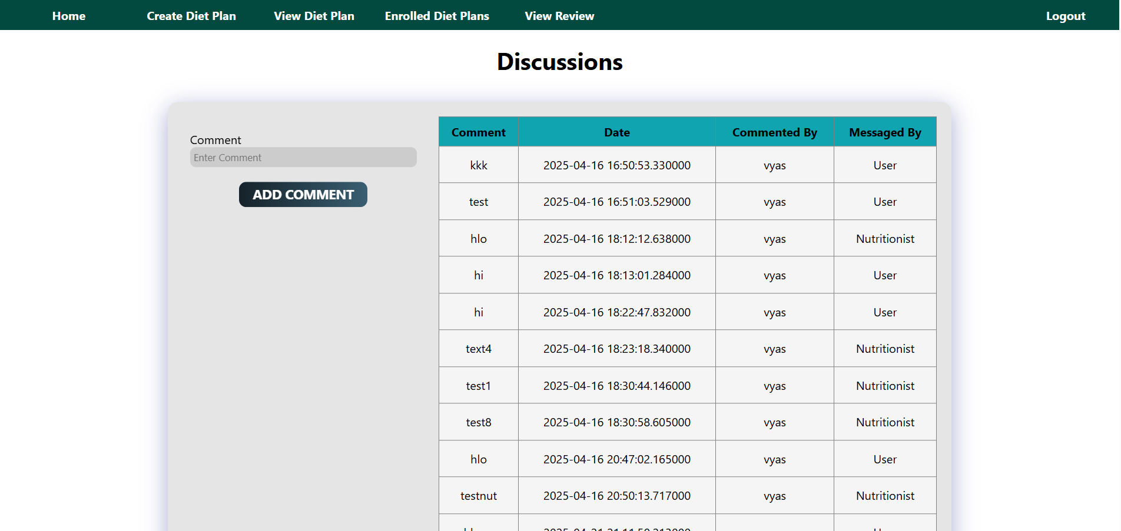
Nutrition Discussions with User:

Slide 36
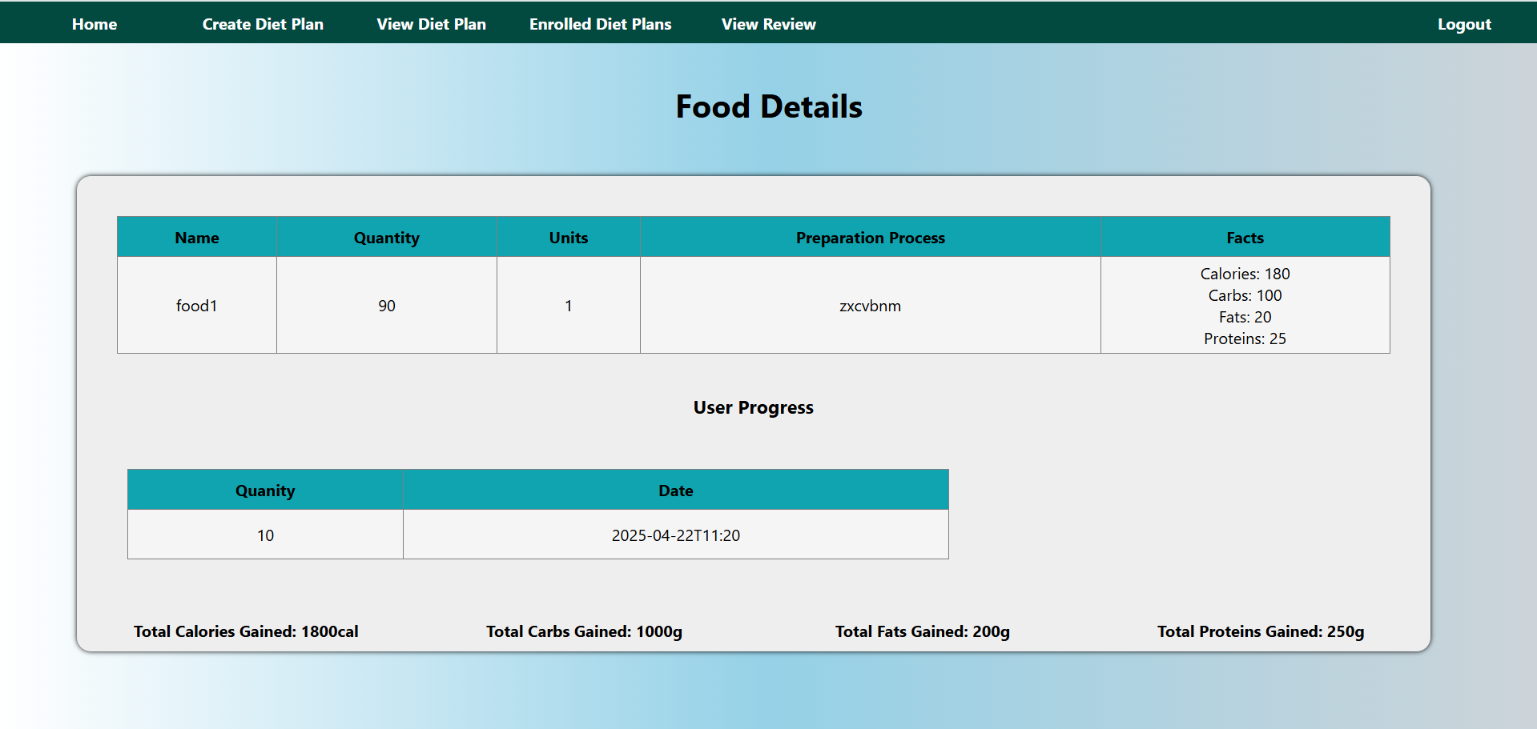
Food Details:

Slide 37
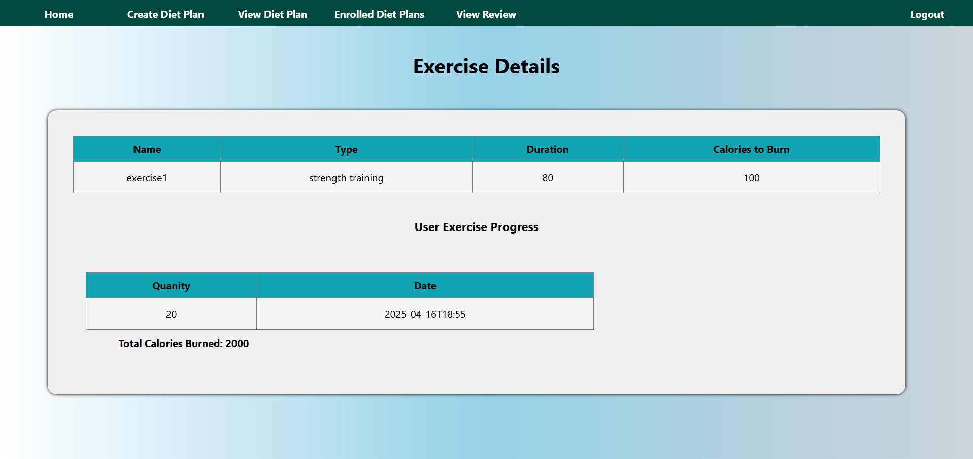
Exercise Details:

Slide 38
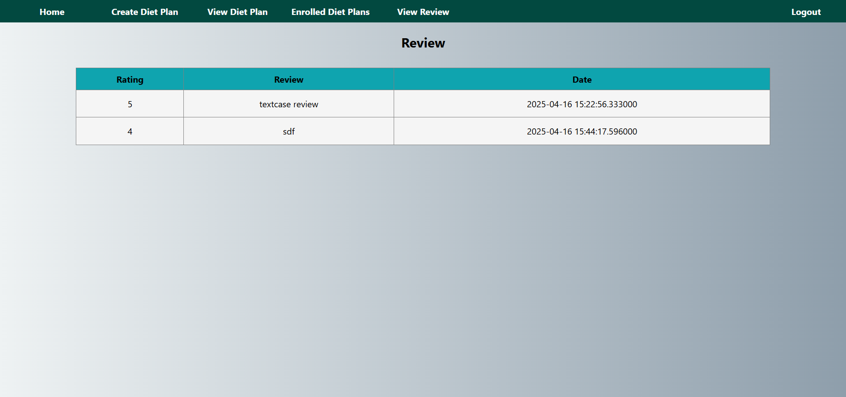
Review:

Slide 39
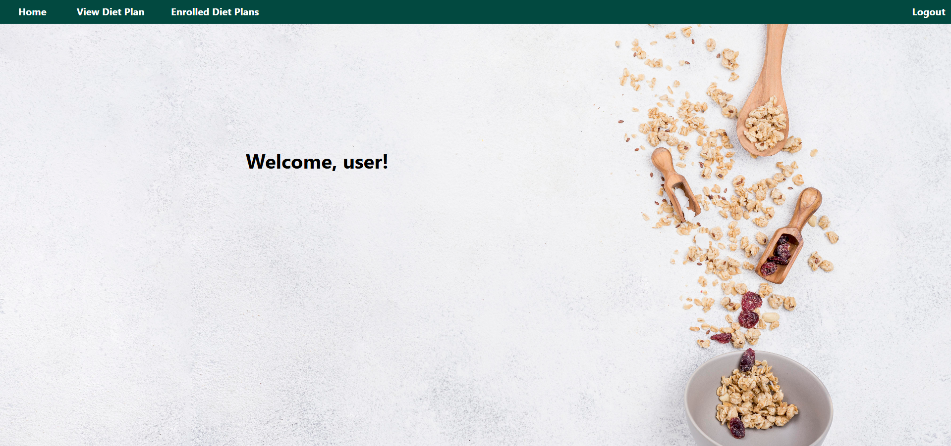

User Home:

Slide 40
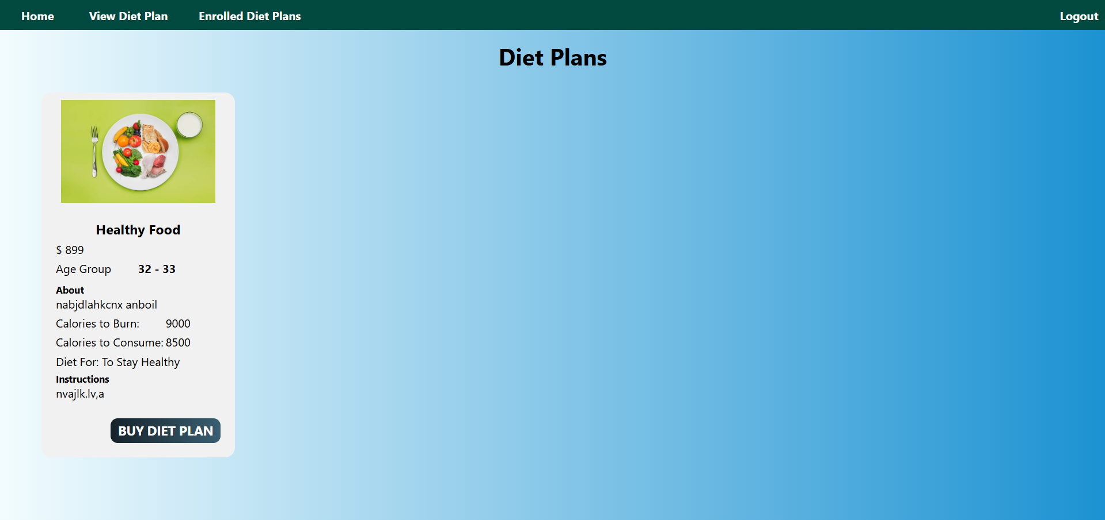
View Verified Diet Plans:

Slide 41
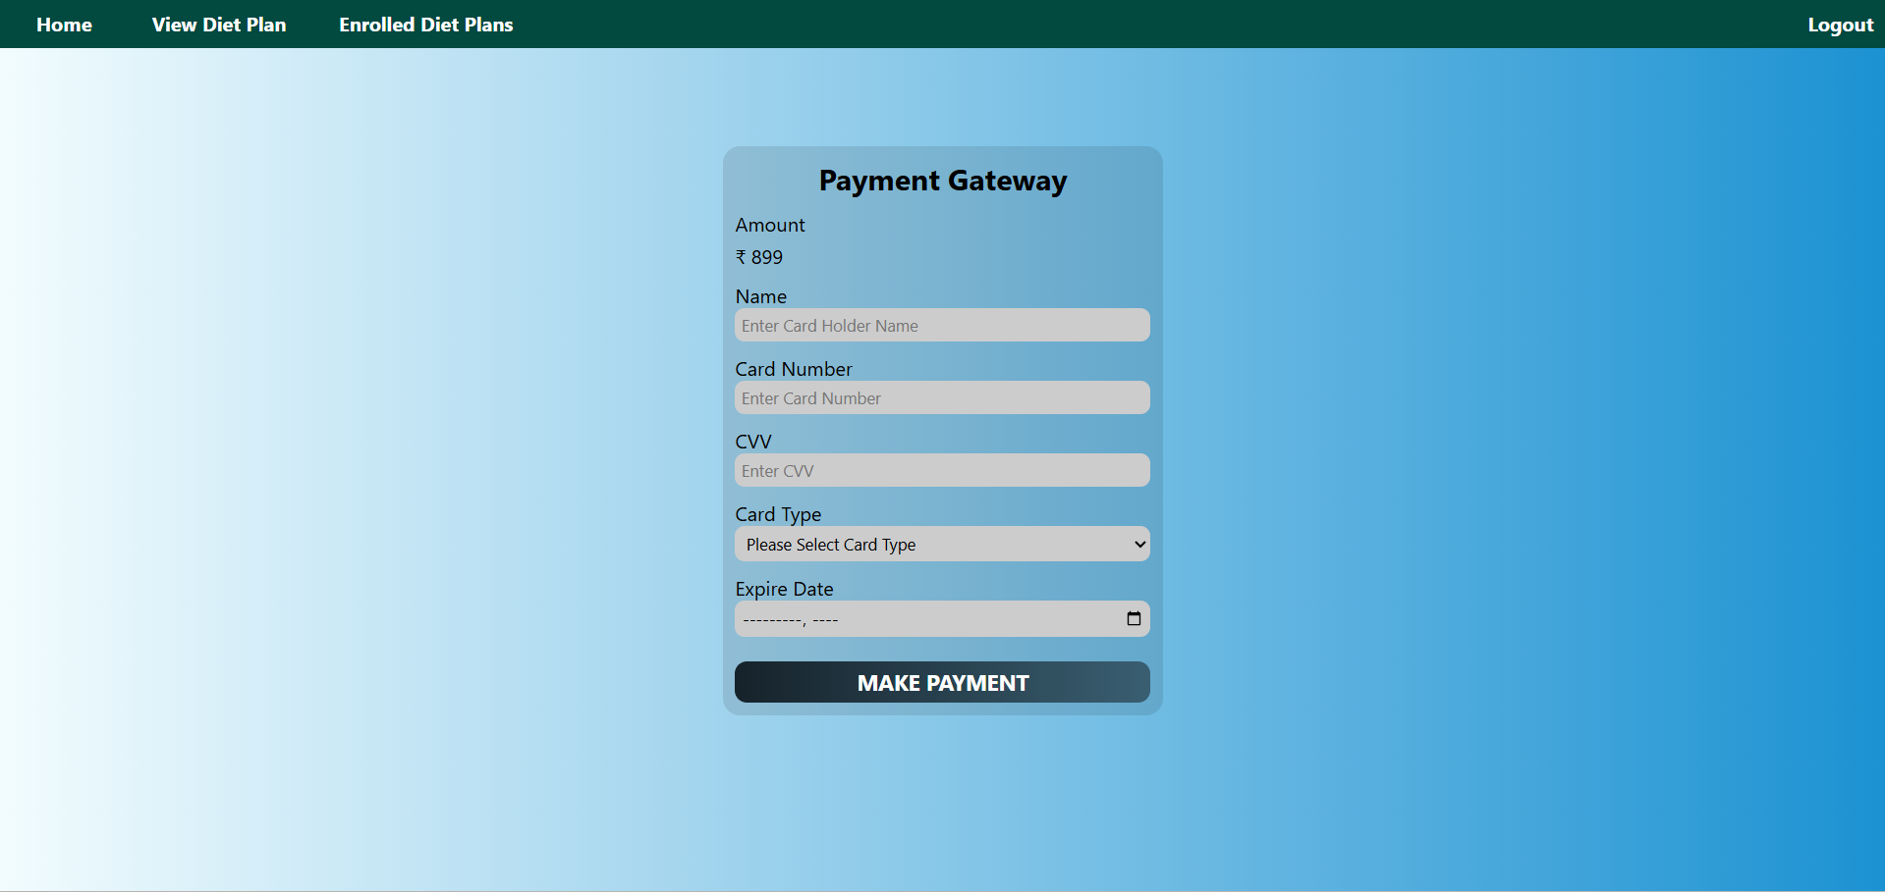
Payment Page:

Slide 42
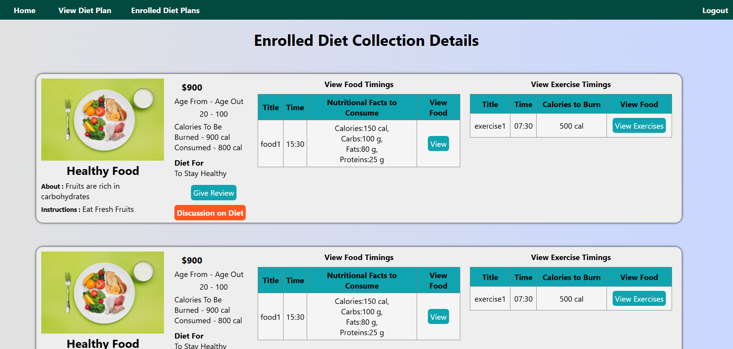
Enrolled Diet Plans:

Slide 43
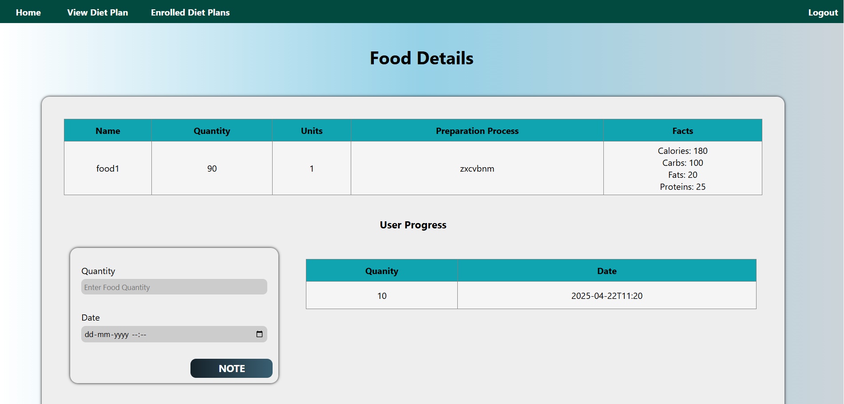
Add User in Diet:

Slide 44
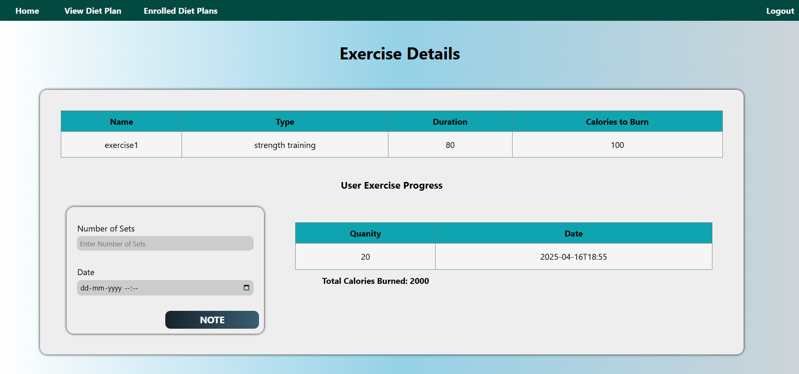
Add Exercises in Diet:

Slide 45
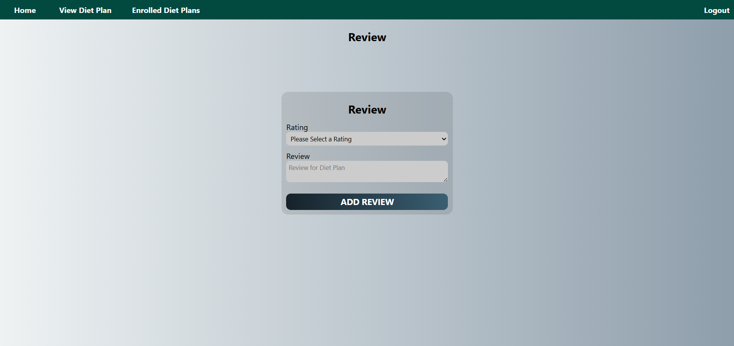
User Review:

Slide 46
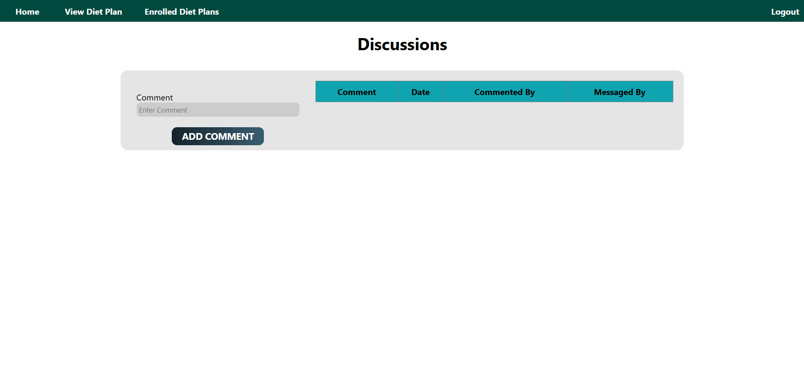
User Discussions on Diet:

Slide 47
Thank you.

